Slide 1
Process Mapping:
[Streamlining the document request process ]

Slide 2
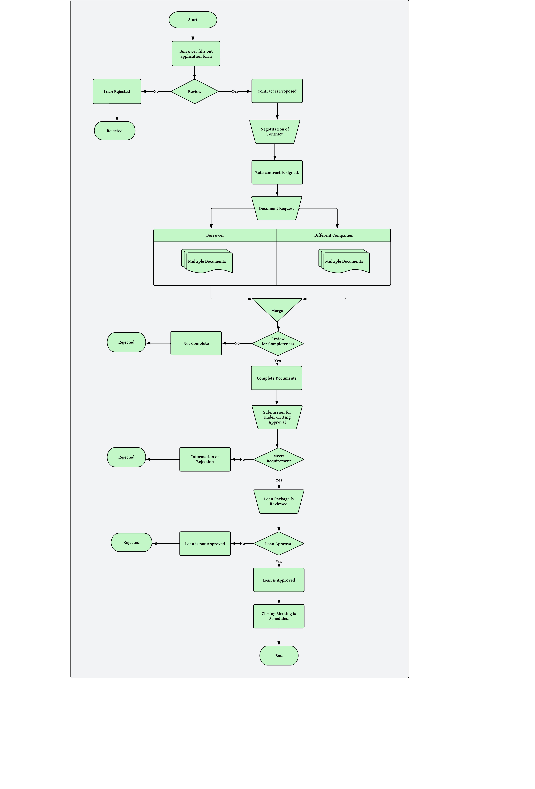
As-Is Process Map: [Streamlining the document request process ]

Slide 3
Opportunities for Process Improvement: [Streamlining the document request process ]
Process Improvement Opportunities
To save time, we could consider:
Streamlining the document request process in Step 7 by sending all document requests to the borrower and relevant companies at once.
Automating the prequalification process in Step 2 using technology such as machine learning algorithms to quickly assess applicant credit.
Both of these changes could help to reduce the time required for the loan approval process.

